Slide 1

Mrs. Dembroski’s Classroom Expectations

Slide 2
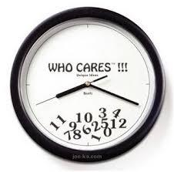
Think of all the people that are impacted (besides you) when you are late.
Respect your education.
Respect why you are here.

Slide 3

EVERY DAY:
* Writing Utensil
* Charged iPad
* Reading Book
* Paper or Notebook

Slide 4
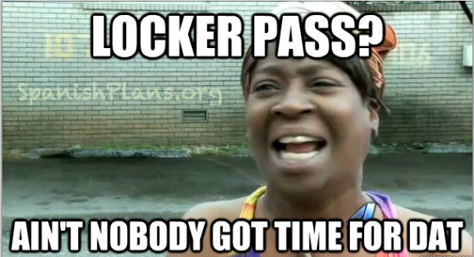
Forgot something?
Adapt and Overcome:
* Borrow
* Paper Drawer

Slide 5
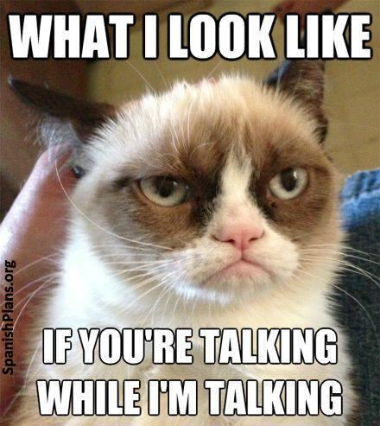
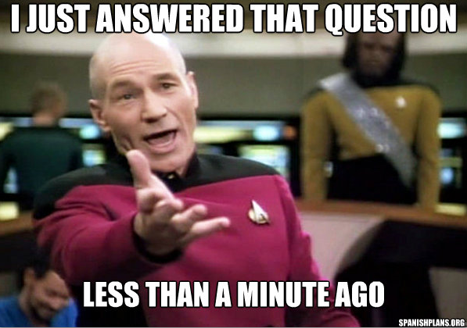

Slide 6
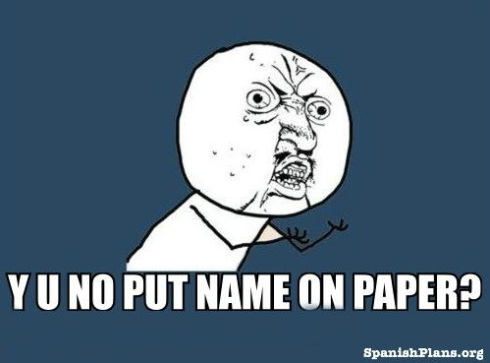
Type or write your name at the top of all documents.

Slide 7
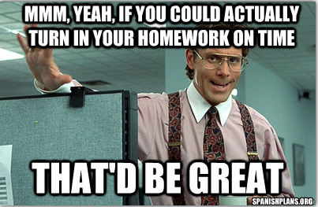
Writing Workshop requires accountability
8th grade = Responsibility and cultivating good habits
Emergency? Email me your paper
Once we move on to a new topic or unit, no late work is accepted.

Slide 8
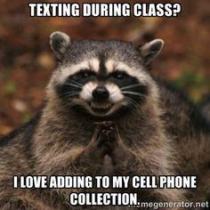
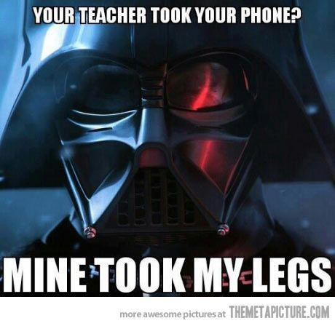

Slide 9
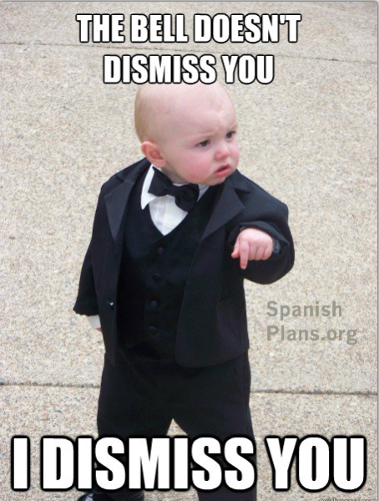
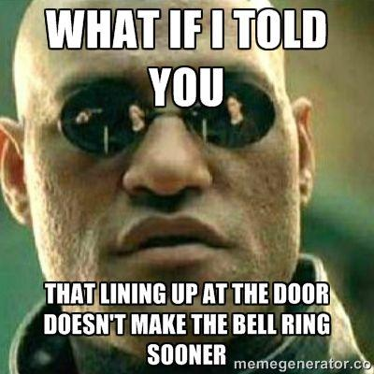

Slide 10
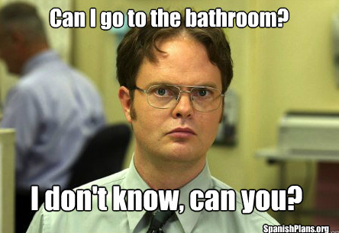
No bathroom breaks in 1st hour.
Timing is everything - be thoughtful about when you ask.

Slide 11
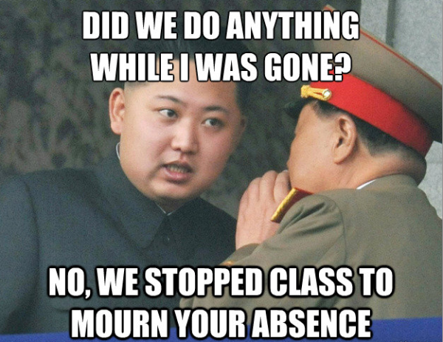
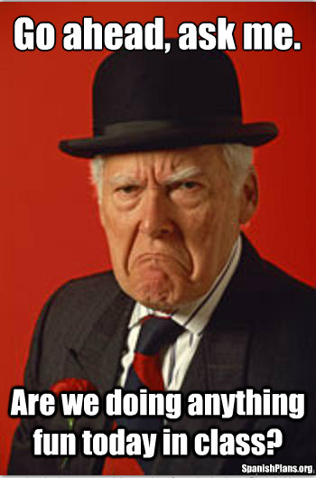
Check the Assignment Board
Check Google Calendars
Ask a trustworthy classmate

Slide 12
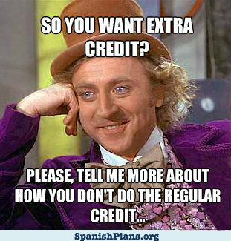
I don’t “do” extra credit. Never have, never will. Fuhgetaboudit.

Slide 13
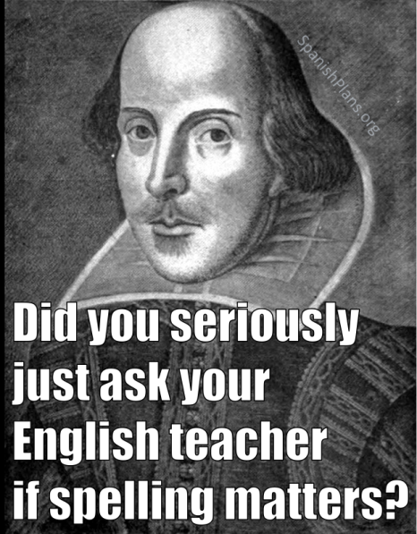
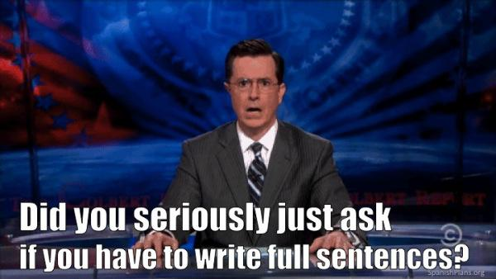
* There’s this thing called Spellcheck.
* Bullet points are permitted for some warm-ups and for brainstorming.
* Cultivate good habits.
* Read it out loud.
* Have someone else read it.

